Slide 1

adding x+y on both side
subtracting 2z on both side
take the common factor out
What? 2 is equal to 1?
cancel (x+y+z) on both side

Slide 2
How come 3 is less than 2 ?

Slide 3

How do we find the sum of the below n terms?
Finally! This is easy

Slide 4
adding x+y on both side
subtracting 2z on both side
take the common factor out
As x+y-z is zero, we cannot cancel it on both side
cancel (x+y+z) on both side
Notes:
put the “x+y-z” in the text bubble in italics

Slide 5
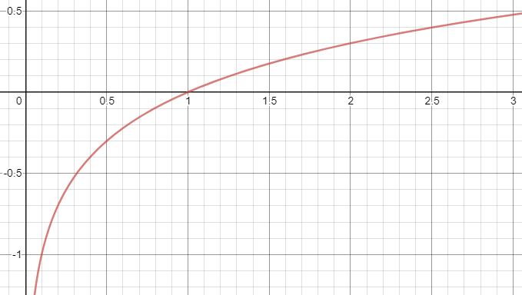
Since Log(1/2) is negative number, we cannot cancel it on both side

Slide 6

Of course we can use a geometric series to sum it up!
but let’s analyze in binary world with 1s and 0s.
Now lets confirm the same with the geometric series formula

Slide 7

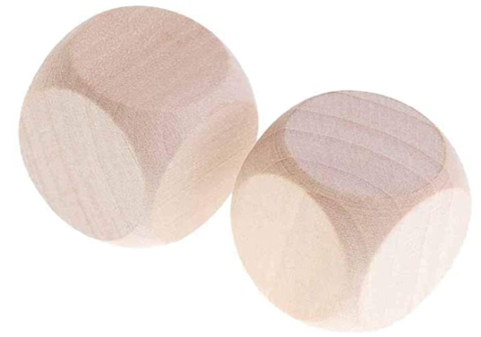

Design 2 dices such that when you roll and sum them, it can be any number between 1 and 36?
We will discuss the solution in my next video.
Finally, I thank you for watching this video. If you have any questions, please leave them in the comment below.
Also if you want me to make a video in any topic of your interest then please do let me know.
If you like this video then give it a thumbs up and share with your friends, don’t forget to subscribe if you already haven’t. Also please click on the bell button for channel updates.

